Slide 1
3D Transformation
Lecture 19

Slide 2
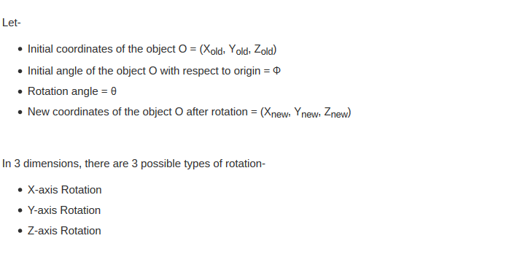
3D Rotation

Slide 3
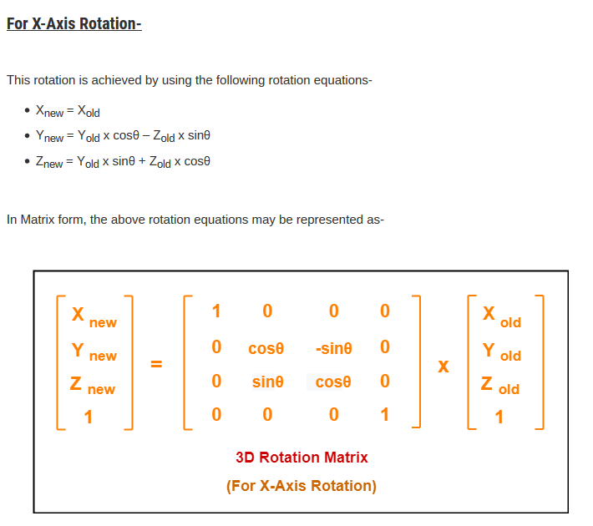
3D Rotation

Slide 4
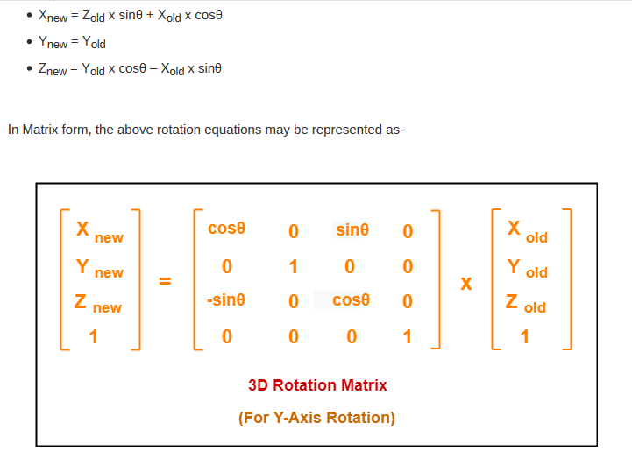
3D Rotation

Slide 5
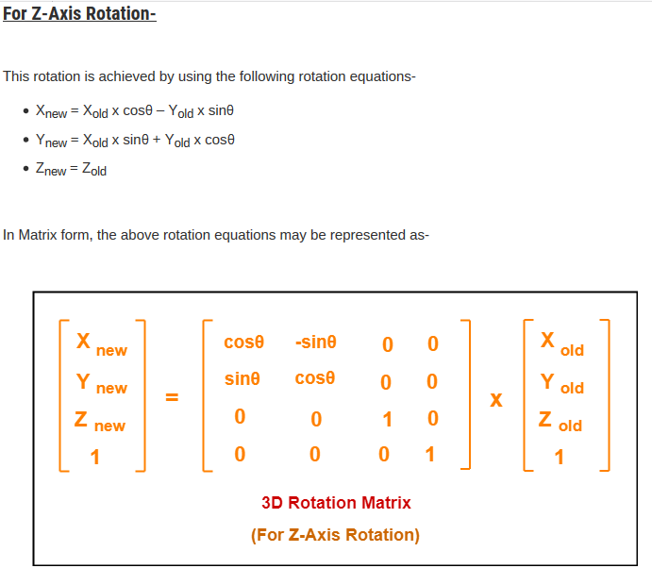
3D Rotation

Slide 6
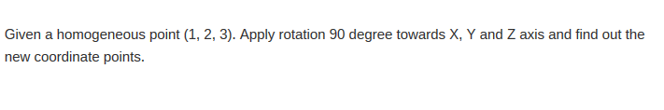
3D Rotation

Slide 7
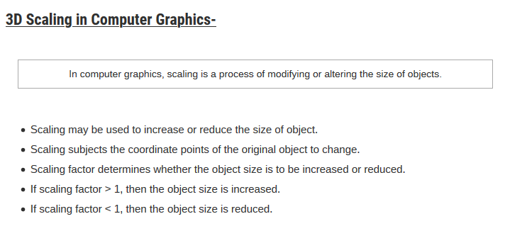
3D Scaling

Slide 8
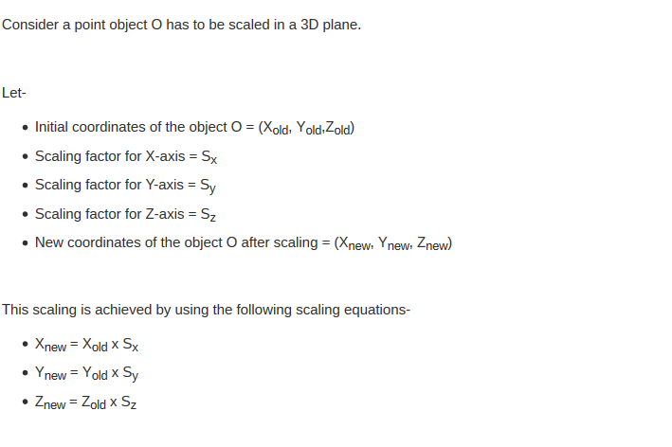
3D Scaling

Slide 9
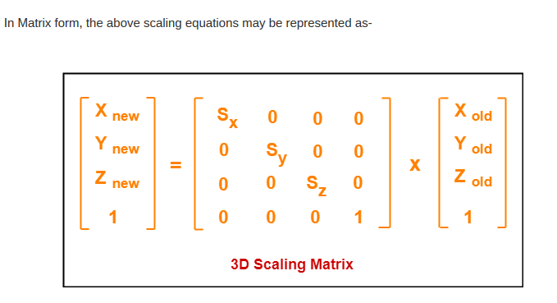
3D Scaling

Slide 10
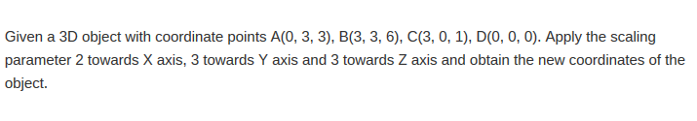
3D Scaling

